Slide 1
MACHINE LEARNING BASED FLOOD PREDICTION
UNDER THE GUIDANCE OF:
JITHESH KURIAN

Slide 2
GROUP MEMBERS
ALPHIN AJ
FREDDY LAWRENCE
UJJWAL BABU
VIMAL PS

Slide 3
INTRODUCTION
In the last 17 years, world has faced more than 3000 natural disasters which include drought , earthquake, extreme temperature, floods and landslides etc..
Flooding is the most common natural disaster on the planet, affecting hundreds of millions of people and causing between 6,000 TO 18,000 fatalities every year – of which 20 percentage are in india .
Flooding occurs when an extreme volume of water is carried by rivers, creeks and many others geographical features into areas where the water cannot be drained adequately
In recent years, there were many parts of countries which are prone to flood like Assam, Bihar, Kerala, Tamil nadu

Slide 4
Characteristics of the catchment, Rainfall , Weather parameters, Drainage and opening of barrage these are some factors causing flood.
Floods are complicated natural events.it depends on several parameters, So it is very difficult to model analytically.
There was much research for the prediction of flood ahead, but not many method give the estimate with high accuracy . The flood prediction analysis majorly uses Machine Learning There are many methods in machine learning to predict the problem with high accuracy.
We have implemented machine learning algorithm like Support Vector Machine( SVM), Random Forest, Gaussian Naïve Bayes.

Slide 5
For training our model here we have considering a data set from the Kaggle which includes india statewise information about the flood and its factors for the 64 years
After the model building, our model will predicts whether flood will affect or not for the coming years based on the inputs.

Slide 6
HARDWARE AND SOFTWARE REQUIREMENT’S
H/W CONFIGURATION:
Processor :- I3/Intel Processor
Hard Disk :- 500 GB
RAM :- 8GB

Slide 7
S/W CONFIGURATIONS :
Operating System :- Windows 7/8/10
Server side Script :- Python
IDE :- Google colab
Libraries Used :- Numpy, Pandas, Seaborn, Scikit-Learn
Technology :- Python 3.6+

Slide 8
IMPLEMENTATION
Collect the data sets available in open resources.
Data cleaning and preprocessing .
Perform Machine Learning algorithms to the available data sets.
Choose the best algorithm based on the performance of the model.
Apply the best model to our target data.
After the model building , based on the input values provided by the user our model predicts whether flood will affect or not.

Slide 9
BLOCK DIAGRAM
START
DATA SPLITTING
DATA CLEANING
MODEL BUILDING
OUTLIER DETECTION
TRAINING & TESTING
SCALING
PREDICTIONS
GRIDSEARCH CV

Slide 10
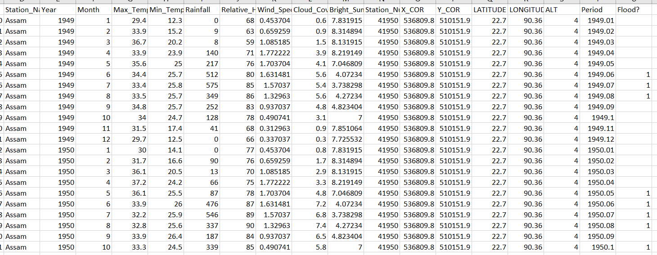
DATA SET

Slide 11
DATA SET
Our data set includes weather data for India from Kaggle for the years 1949 to 2013, as well as data from the Indian Meteorological Department (IMD).
Flood data for a specific month and year was gathered from a variety of sources, including annual flood reports, newspapers, research papers, and so on, and then merged with IMD weather data to predict flood occurrence.
The dataset contains information for 21 states of india. Some of the important attributes of the dataset include Rainfall, Cloud Coverage, Relative Humidity, Minimum Temperature, Wind Speed, etc.
dataset which consists of 20544 instances(20544*13).

Slide 12
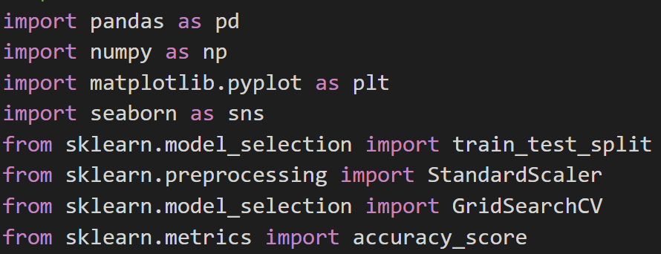
REQUIRED DEPENDENCIES

Slide 13
ALGORITHMS
RANDOM FOREST CLASSIFIER
Random Forest is a popular machine learning algorithm that belongs to the supervised learning technique. It can be used for both Classification and Regression problems in ML.
It is based on the concept of ensemble learning, which is a process of combining multiple classifiers to solve a complex problem and to improve the performance of the model.

Slide 14
K-NEAREST NEIGHBORS
K-Nearest Neighbour is one of the simplest Machine Learning algorithms based on Supervised Learning technique.
K-NN algorithm stores all the available data and classifies a new data point based on the similarity
K-NN is a non-parametric algorithm, which means it does not make any assumption on underlying data

Slide 15
SUPPORT VECTOR CLASSIFIER(SVC)
Support Vector Classifier, is a supervised machine learning algorithm typically used for classification tasks coming under SVM(Support Vector Machine).
In case of 2D space where there are two features boundary is a line, in 3D space plane is considered as a boundary.In n dimensional space Support Vector Machine draws a hyperplane such that it maximizes margin between classification groups
Effective in high dimensional cases

Slide 16
LOGISTIC REGRESSION
Logistic regression which comes under the Supervised Learning technique. It is used for predicting the categorical dependent variable using a given set of independent variables.
Logistic regression predicts the output of a categorical dependent variable. Therefore the outcome must be a categorical or discrete value. It can be either Yes or No, 0 or 1, true or False, etc.

Slide 17
GRIDSEARCHCV
GridSearchCV is the process of performing hyperparameter tuning in order to determine the optimal values for a given model.
GridSearchCV is a function that comes in Scikit-learn’s(or SK-learn) model_selection package.
From the above mentioned 4 algorithms , GridSearchCV help to select the best model aand its optimal parameters value for more accurate prediction

Slide 18
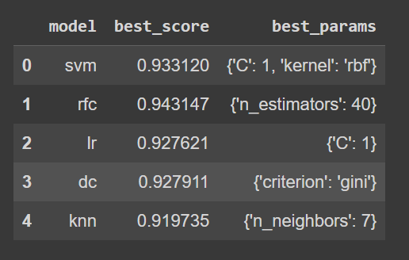
BEST MODEL

Slide 19
GOOGLE COLAB

Slide 20
CONCLUSION
It is very important for India to predict flood as accurately as possible because only then, India will be able to alleviate the after-effects of floods.
This Python code may be turned into a programme that forecasts the occurrence of floods by giving the necessary weather data, which represents an amazing way to partially prevent the calamity.

Slide 21
REFERENCES
1] A. O. Hashi, A. A. Abdirahman, M. A. Elmi, and S. Z. Mohd, “A Real-Time Flood Detection System Based on Machine Learning Algorithms with Emphasis on Deep Learning,” vol. 69, no. 5, pp. 249–256, 2021, doi: 10.14445/22315381/IJETT-V69I5P232.
[2] M. Moishin, R. C. Deo, R. Prasad, N. Raj, and S. Abdulla, “Designing deep-based learning flood forecast model with ConvLSTM hybrid algorithm,” IEEE Access, vol. 9, pp. 50982– 50993, 2021, doi: 10.1109/ACCESS.2021.3065939.
[3] A. Mosavi, P. Ozturk, and K. Chau, “Flood Prediction Using Machine Learning Models : Literature Review,” no. Idi.
[4] V. B. S and S. Sandhya, “Flood Prediction System using Multilayer Perceptron Classifier and Neural Networks,” no. May, pp. 6245–6254, 2020.

Slide 22
THANK YOU

